Slide 1
Data Structure and Algorithm (PMSCS 623P)
Lecture 4

Slide 2

Linear Arrays
A linear array is a list of a finite number of n homogeneous data elements ( that is data elements of the same type) such that.
The elements are of the arrays are referenced respectively by an index set consisting of n consecutive numbers.
The elements of the arrays are stored respectively in successive memory locations.
2

Slide 3

Linear Arrays
The number n of elements is called the length or size of the array.
The index set consists of the integer 0,1, 2, …n-1
Length or the number of data elements of the array can be obtained from the index set by
Length = UB – LB + 1
where
UB is the largest index called the upper bound and
LB is the smallest index called the lower bound of the arrays
3

Slide 4

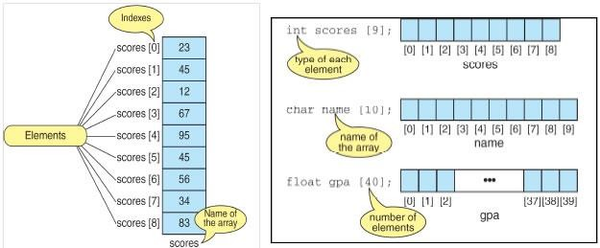
Linear Arrays
Element of an array A may be denoted by
Subscript notation A₁, A₂, , …. , A_{n}
Parenthesis notation A(1), A(2), …. , A(n)
Bracket notation A[1], A[2], ….. , A[n]
The number K in A[K] is called subscript or an index and A[K] is called a subscripted variable.
4

Slide 5


Declaring and Initializing Arrays
Initializing Arrays
Initialization of an array either one by one or using a single statement as follows −
int ar[5];
ar[0]=10; ar[1]=20;
double balance[5] = {1000.0, 2.0, 3.4, 7.0, 50.0};

Slide 6

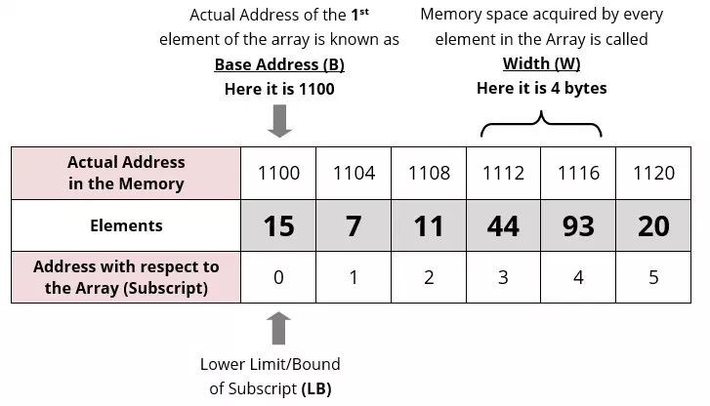
Representation of Linear Array in Memory
10

Slide 7

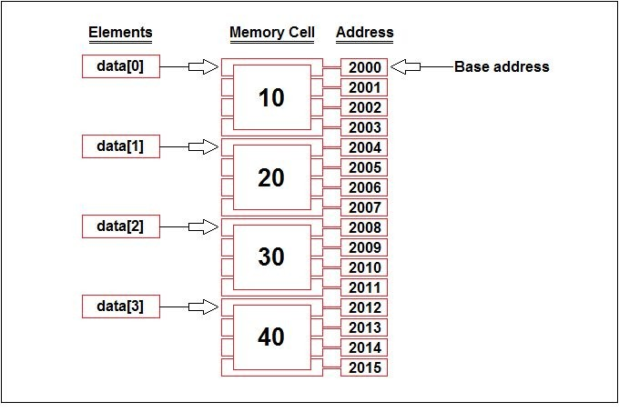
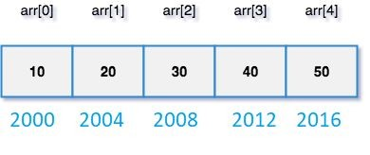
Representation of Linear Array in Memory

Slide 8

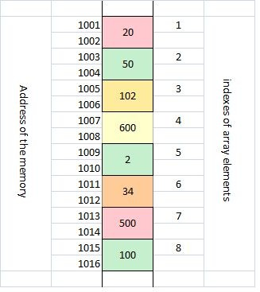
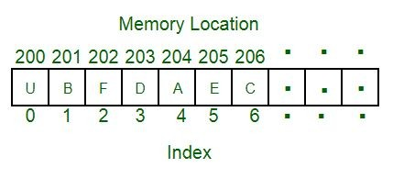
Representation of Linear Array in Memory

Slide 9

Example 1
Find the address for LA[6] Each element of the array occupy 1 byte
200
201
202
203
204
205
206
207
LA[1]
LA[2]
LA[3]
LA[4]
LA[5]
LA[6]
LA[7]
LA[8]
LOC(LA[K]) = Base(LA) + w(K – lower bound)
:
LOC(LA[6]) = 200 + 1(6 – 1) =
205
9

Slide 10

Example 2
Find the address for LA[16] Each element of the array occupy 2 byte
200
201
202
203
204
205
206
207
LA[0]
LA[1]
LA[2]
LA[3]
LOC(LA[K]) = Base(LA) + w(K – lower bound) :
LOC(LA[16]) = 200 + 2(16 – 0)
= 232
10

Slide 11
Data Structures
Operations on Linear Array
Traversing: means to visit all the elements of the array in an operation is called traversing.
Insertion: means to put values into an array.
Deletion / Remove: to delete a value from an array.
Sorting: Re-arrangement of values in an array in a specific order (Ascending / Descending) is called sorting.
Searching: The process of finding the location of a particular element in an array is called searching.
There are two popular searching techniques/mechanisms: Linear search and binary search.

Slide 12
The Search Problem
Given an array A storing n numbers, and a target number v, locate the position in A (if it exists) where A[i] = v
Example
Input: A = {3,8,2,15,99,52}, v = 99
Output: position 4
Notes
Array positions (indexes) go from 0..n-1
When the target does not exist in the array, return an undefined position, such as -1

Slide 13
Algorithm 1: Linear Search
Algorithm LinearSearch(A,v):
Input: An array A of n numbers, search
target v
Output: position i where A[i]=v, -1 if not
found
for i ← 0 to n - 1 do
if A[i] = v then
return i
return -1

Slide 14
Linear Search time complexity
Worst-case: O( n )
If v does not exist or if v is the last element in the array
Best-case: O( 1 )
When the target element v is the first element in the array
Average-case: O( n )
e.g., if the target element is somewhere in the middle of the array, the for-loop will iterate n/2 times. Still O( n )

Slide 15
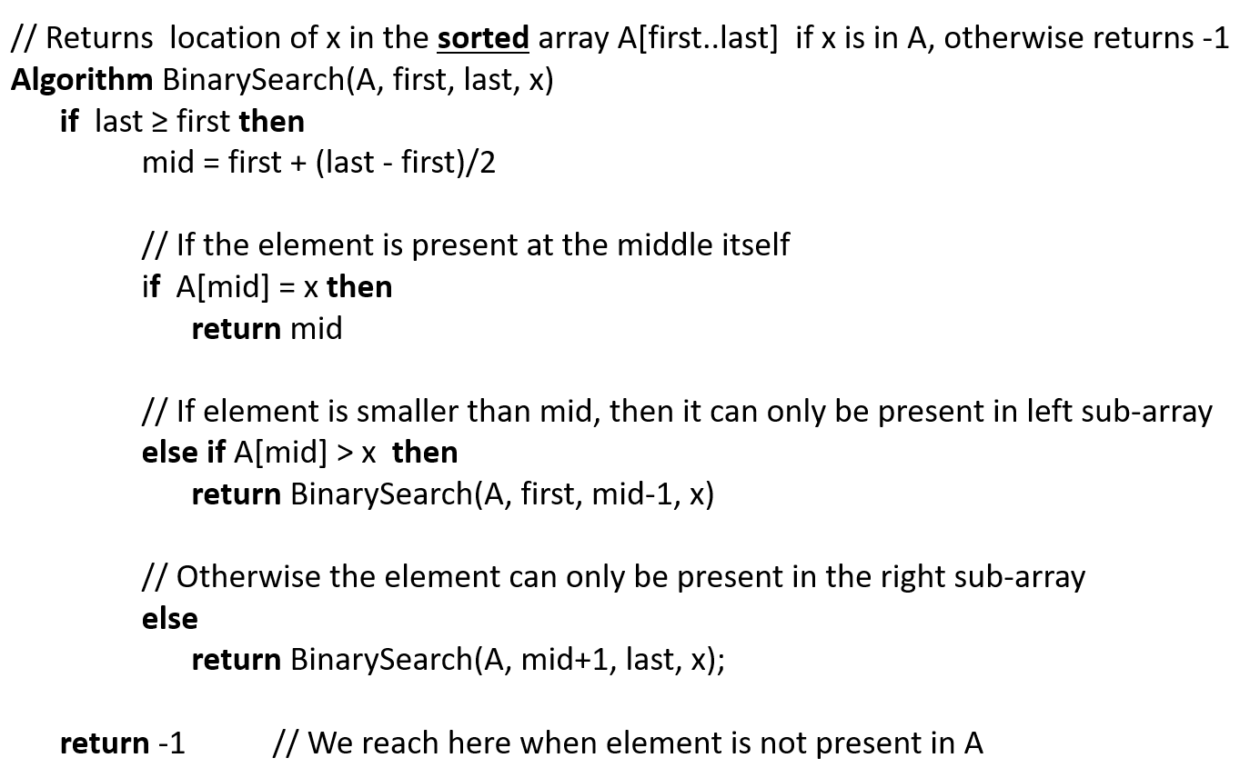
Binary Search (recursive)

Slide 16
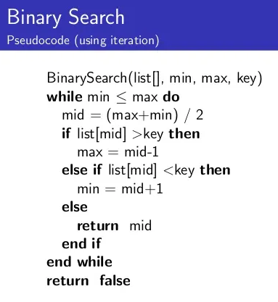
Binary Search (iteration)

Slide 17
Retrieving an Item from Sorted List
Find 84
6
13
14
25
33
43
51
53
64
72
84
93
95
96
97
0
1
2
3
4
5
6
7
8
9
10
11
12
13
14

Slide 18
Retrieving an Item from Sorted List
Find 84
Step 1
6
13
14
25
33
43
51
53
64
72
84
93
95
96
97
0
1
2
3
4
5
6
7
8
9
10
11
12
13
14
first
last

Slide 19
Retrieving an Item from Sorted List
Find 84
Step 1
6
13
14
25
33
43
51
53
64
72
84
93
95
96
97
0
1
2
3
4
5
6
7
8
9
10
11
12
13
14
first
mid
=(0+14)/2
last

Slide 20
Retrieving an Item from Sorted List
Find 84
Step 1
6
13
14
25
33
43
51
53
64
72
84
93
95
96
97
0
1
2
3
4
5
6
7
8
9
10
11
12
13
14
first
mid
=(0+14)/2
last

Slide 21
Retrieving an Item from Sorted List
Find 84
Step 2
6
13
14
25
33
43
51
53
64
72
84
93
95
96
97
0
1
2
3
4
5
6
7
8
9
10
11
12
13
14
first
last

Slide 22
Retrieving an Item from Sorted List
Find 84
Step 2
6
13
14
25
33
43
51
53
64
72
84
93
95
96
97
0
1
2
3
4
5
6
7
8
9
10
11
12
13
14
first
mid
=(8+14)/2
last

Slide 23
Retrieving an Item from Sorted List
Find 84
Step 2
6
13
14
25
33
43
51
53
64
72
84
93
95
96
97
0
1
2
3
4
5
6
7
8
9
10
11
12
13
14
first
mid
=(8+14)/2
last

Slide 24
Retrieving an Item from Sorted List
Find 84
Step 3
6
13
14
25
33
43
51
53
64
72
84
93
95
96
97
0
1
2
3
4
5
6
7
8
9
10
11
12
13
14
first
last

Slide 25
Retrieving an Item from Sorted List
Find 84
Step 3
6
13
14
25
33
43
51
53
64
72
84
93
95
96
97
0
1
2
3
4
5
6
7
8
9
10
11
12
13
14
first
last
mid
=(8+10)/2

Slide 26
Retrieving an Item from Sorted List
Find 84
Step 3
6
13
14
25
33
43
51
53
64
72
84
93
95
96
97
0
1
2
3
4
5
6
7
8
9
10
11
12
13
14
first
last
mid
=(8+10)/2

Slide 27
Retrieving an Item from Sorted List
Find 84
Step 4
6
13
14
25
33
43
51
53
64
72
84
93
95
96
97
0
1
2
3
4
5
6
7
8
9
10
11
12
13
14
first
last

Slide 28
Retrieving an Item from Sorted List
Find 84
Step 4
84 found at the midpoint
6
13
14
25
33
43
51
53
64
72
84
93
95
96
97
0
1
2
3
4
5
6
7
8
9
10
11
12
13
14
first
last
mid
=(10+10)/2

Slide 29
Retrieving an Item from Sorted List
Find 73
6
13
14
25
33
43
51
53
64
72
84
93
95
96
97
0
1
2
3
4
5
6
7
8
9
10
11
12
13
14

Slide 30
Retrieving an Item from Sorted List
Find 73
Step 1
6
13
14
25
33
43
51
53
64
72
84
93
95
96
97
0
1
2
3
4
5
6
7
8
9
10
11
12
13
14
first
last

Slide 31
Retrieving an Item from Sorted List
Find 73
Step 1
6
13
14
25
33
43
51
53
64
72
84
93
95
96
97
0
1
2
3
4
5
6
7
8
9
10
11
12
13
14
first
mid
=(0+14)/2
last

Slide 32
Retrieving an Item from Sorted List
Find 73
Step 1
6
13
14
25
33
43
51
53
64
72
84
93
95
96
97
0
1
2
3
4
5
6
7
8
9
10
11
12
13
14
first
mid
=(0+14)/2
last

Slide 33
Retrieving an Item from Sorted List
Find 73
Step 2
6
13
14
25
33
43
51
53
64
72
84
93
95
96
97
0
1
2
3
4
5
6
7
8
9
10
11
12
13
14
first
last

Slide 34
Retrieving an Item from Sorted List
Find 73
Step 2
6
13
14
25
33
43
51
53
64
72
84
93
95
96
97
0
1
2
3
4
5
6
7
8
9
10
11
12
13
14
first
mid
=(8+14)/2
last

Slide 35
Retrieving an Item from Sorted List
Find 73
Step 2
6
13
14
25
33
43
51
53
64
72
84
93
95
96
97
0
1
2
3
4
5
6
7
8
9
10
11
12
13
14
first
mid
=(8+14)/2
last

Slide 36
Retrieving an Item from Sorted List
Find 73
Step 3
6
13
14
25
33
43
51
53
64
72
84
93
95
96
97
0
1
2
3
4
5
6
7
8
9
10
11
12
13
14
first
last

Slide 37
Retrieving an Item from Sorted List
Find 73
Step 3
6
13
14
25
33
43
51
53
64
72
84
93
95
96
97
0
1
2
3
4
5
6
7
8
9
10
11
12
13
14
first
last
mid
=(8+10)/2

Slide 38
Retrieving an Item from Sorted List
Find 73
Step 3
6
13
14
25
33
43
51
53
64
72
84
93
95
96
97
0
1
2
3
4
5
6
7
8
9
10
11
12
13
14
first
last
mid
=(8+10)/2

Slide 39
Retrieving an Item from Sorted List
Find 73
Step 4
6
13
14
25
33
43
51
53
64
72
84
93
95
96
97
0
1
2
3
4
5
6
7
8
9
10
11
12
13
14
first
last

Slide 40
Retrieving an Item from Sorted List
Find 73
Step 4
6
13
14
25
33
43
51
53
64
72
84
93
95
96
97
0
1
2
3
4
5
6
7
8
9
10
11
12
13
14
first
last
mid
=(10+10)/2

Slide 41
Retrieving an Item from Sorted List
Find 73
Step 5
Item != info[mid] (indicates the absence of the item)
6
13
14
25
33
43
51
53
64
72
84
93
95
96
97
0
1
2
3
4
5
6
7
8
9
10
11
12
13
14
last
first

Slide 42
Binary Search (recursive)

Slide 43
Time complexity analysis
Examining the algorithm yields the following observations:
The non-recursive work takes constant time C.
The single recursive call has input half the size of the original.
The algorithm terminates when the array has size no larger than one.

Slide 44
Analysis: solving recurrence
T(n) = T(n/2) + O(1), and O(1)=c
Since n=2^{k}, we have k=log₂ n

Slide 45


Time complexity analysis
To analyze the binary search algorithm, we need to recall that from consideration. each comparison eliminates about half of the remaining items
What is the maximum number of comparisons this algorithm will require to check the entire list?
If we start with n items, about n/2 items will be left after the first comparison. After the second comparison, there will be about n/4. Then n/8, n/16, and so on.
So the worst case would be
That shows the worst case is when you reach N/2^{x} where x is such that 2^{x} = N . Now since mathematically worst case is when the value of

Slide 46
Data Structures
Complexity of the Binary Search Algorithm
The Complexity of the Binary Search algorithm is measured by the maximum (worst case) number of Comparisons it performs for searching operations. The searched array is divided by 2 for each comparison/iteration. Therefore, we require at most f(n) comparisons to locate ITEM:
2^{f(n)} > n or equivalently, f(n) = + 1
Approximately, equal to log₂n.
Example:
If a given sorted array contains 1024 elements, then the maximum number of comparisons required is:
log₂(1024) = 10 (only 10 comparisons are enough)

Slide 47
Data Structures
Limitations of the Binary Search Algorithm
The algorithm requires two conditions:
The list must be sorted.
One must have direct access to the middle element in any sub list.

Slide 48
Data Structures
Insertion into Arrays
Inserting an element somewhere in the middle of the array require that each subsequent element be moved downward to new locations to accommodate the new element and keep the order of the other elements.
Algorithm 4.2: (Inserting into a linear array)
Here LA is linear array with N elements and K is a positive integer such that K<=N. This algorithm inserts an element ITEM into the K-th position in LA.
Step 1. Set J:=N
Step 2. Repeat Steps 3 and 4 while J>=K
Step 3. Set LA [J+1]: =LA [J]
Step 4. Set J:=J-1
[End of step 2 loop]
Step 5. Set LA [K]: =ITEM
Step 6. Set N:=N+1
Step 7. Exit

Slide 49
Data Structures
Deletion of elements from linear arrays
Deleting an element somewhere in the middle of the array requires that each subsequent element be moved one location upward in order to “fill up” the array.
Algorithm 4.3: (Deleting from a linear array)
Here LA is a linear array with N elements and K is a positive integer such that K≤N. This algorithm deletes the K-th element from LA.
Step 1. Set ITEM: = LA [K]
Step 2. Repeat for J=K to N-1
Set LA [J]: =LA [J+1]
[End of loop]
Step 3. Set N:=N-1
Step 4. Exit

Slide 50
"Bubbling Up" the Largest Element
Traverse a collection of elements
Move from the front to the end
“Bubble” the largest value to the end using pair-wise comparisons and swapping
1 2 3 4 5 6
77
42
35
12
101
5

Slide 51
"Bubbling Up" the Largest Element
Traverse a collection of elements
Move from the front to the end
“Bubble” the largest value to the end using pair-wise comparisons and swapping
Swap
1 2 3 4 5 6
42
77
77
42
35
12
101
5

Slide 52
"Bubbling Up" the Largest Element
Traverse a collection of elements
Move from the front to the end
“Bubble” the largest value to the end using pair-wise comparisons and swapping
1 2 3 4 5 6
Swap
35
77
42
77
35
12
101
5

Slide 53
"Bubbling Up" the Largest Element
Traverse a collection of elements
Move from the front to the end
“Bubble” the largest value to the end using pair-wise comparisons and swapping
1 2 3 4 5 6
Swap
12
77
42
35
77
12
101
5

Slide 54
"Bubbling Up" the Largest Element
Traverse a collection of elements
Move from the front to the end
“Bubble” the largest value to the end using pair-wise comparisons and swapping
1 2 3 4 5 6
42
35
12
77
101
5
No need to swap

Slide 55
"Bubbling Up" the Largest Element
Traverse a collection of elements
Move from the front to the end
“Bubble” the largest value to the end using pair-wise comparisons and swapping
1 2 3 4 5 6
Swap
5
101
42
35
12
77
101
5

Slide 56
"Bubbling Up" the Largest Element
Traverse a collection of elements
Move from the front to the end
“Bubble” the largest value to the end using pair-wise comparisons and swapping
1 2 3 4 5 6
101
42
35
12
77
5
Largest value correctly placed

Slide 57
Bubble Sort
12
12
6
6
6
12
12
6
22
14
14
22
8
8
17
22
17
22
14
8
14
8
17
22
17
22
6
14
6
12
12
8
14
14
8
8
17
22
8
14
17
22
Given n numbers to sort:
Repeat the following n-1 times:
For each pair of adjacent numbers:
If the number on the left is greater than the number on the right, swap them.

Slide 58
Bubble Sort
8
6
8
12
6
12
12
8
12
14
17
22
8
14
17
22
8
6
8
12
6
12
14
17
22
14
17
22
Given n numbers to sort:
Repeat the following n-1 times:
For each pair of adjacent numbers:
If the number on the left is greater than the number on the right, swap them.

Slide 59
Bubble Sort
Given n numbers to sort:
Repeat the following n-1 times:
For each pair of adjacent numbers:
If the number on the left is greater than the number on the right, swap them
How efficient is bubble sort?
In general, given n numbers to sort, it performs n² comparisons
The same as selection sort
Is there a simple way to improve on the basic bubble sort?
Yes! Stop after going through without making any swaps
This will only help some of the time

Slide 60
Bubble Sort
Given n numbers to sort:
Repeat the following n-1 times:
For each pair of adjacent numbers:
If the number on the left is greater than the number on the right, swap them
Try one!
15 | 3 | 11 | 19 | 4 | 7

Slide 61
Data Structures
Bubble Sort
Suppose the following numbers are stored in an array A:
A: 32, 51, 27, 85, 66, 23, 13, 57
Apply the bubble sort to the array A. Show each pass separately.
Pass 1: (a) Compare A₁ and A₂. Since 32< 51, the list is not altered.
A: 32, 51, 27, 85, 66, 23, 13, 57
(b) Compare A₂ and A_{3.} Since 51>27, interchange 51 and 27.
A: 32, 27, 51, 85, 66, 23, 13, 57
(c) Compare A₃ and A_{4.} Since 51<85, the list is not altered.
A: 32, 27, 51, 85, 66, 23, 13, 57
(d) Compare A₄ and A_{5.} Since 85>66, interchange 85 and 66.
A: 32, 27, 51, 66, 85, 23, 13, 57

Slide 62
Data Structures
Bubble Sort
Suppose the following numbers are stored in an array A:
A: 32, 51, 27, 85, 66, 23, 13, 57
Apply the bubble sort to the array A. Show each pass separately.
Pass 1: (e) Compare A₅ and A_{6.} Since 85>23, interchange 85 and 23.
A: 32, 27, 51, 66, 23, 85, 13, 57
(f) Compare A₆ and A_{7.} Since 85>13, interchange 85and 13.
A: 32, 27, 51, 66, 23, 13, 85, 57
(g) Compare A₇and A_{8.} Since 85>57, interchange 85 and 57.
A: 32, 27, 51, 66, 23, 13, 57, 85

Slide 63
Data Structures
Bubble Sort
Suppose the following numbers are stored in an array A:
A: 32, 51, 27, 85, 66, 23, 13, 57
Apply the bubble sort to the array A. Show each pass separately.
After Pass 1: A: 32, 27, 51, 66, 23, 13, 57, 85
Pass 2: 27, 32, 51, 66, 23, 13, 57, 85
27, 32, 51, 66, 23, 13, 57, 85
27, 32, 51, 66, 23, 13, 57, 85
27, 32, 51, 23, 66, 13, 57, 85
27, 32, 51, 23, 13, 66, 57, 85
27, 32, 51, 23, 13, 57, 66, 85

Slide 64
Data Structures
Bubble Sort
Suppose the following numbers are stored in an array A:
A: 32, 51, 27, 85, 66, 23, 13, 57
Apply the bubble sort to the array A. Show each pass separately.
After Pass 1: A: 32, 27, 51, 66, 23, 13, 57, 85
After Pass 2: A: 27, 32, 51, 23, 13, 57, 66, 85
Pass 3: 27, 32, 51, 23, 13, 57, 66, 85
27, 32, 51, 23, 13, 57, 66, 85
27, 32, 23, 51, 13, 57, 66, 85
27, 32, 23, 13, 51, 57, 66, 85
27, 32, 23, 13, 51, 57, 66, 85

Slide 65
Data Structures
Bubble Sort
Suppose the following numbers are stored in an array A:
A: 32, 51, 27, 85, 66, 23, 13, 57
Apply the bubble sort to the array A. Show each pass separately.
After Pass 1: A: 32, 27, 51, 66, 23, 13, 57, 85
After Pass 2: A: 27, 32, 51, 23, 13, 57, 66, 85
After Pass 3: A: 27, 32, 23, 13, 51, 57, 66, 85
Pass 4: 27, 32, 23, 13, 51, 57, 66, 85
27, 23, 32, 13, 51, 57, 66, 85
27, 23, 13, 32, 51, 57, 66, 85
27, 23, 13, 32, 51, 57, 66, 85

Slide 66
Data Structures
Bubble Sort
Suppose the following numbers are stored in an array A:
A: 32, 51, 27, 85, 66, 23, 13, 57
Apply the bubble sort to the array A. Show each pass separately.
After Pass 1: A: 32, 27, 51, 66, 23, 13, 57, 85
After Pass 2: A: 27, 32, 51, 23, 13, 57, 66, 85
After Pass 3: A: 27, 32, 23, 13, 51, 57, 66, 85
After Pass 4: A: 27, 23, 13, 32, 51, 57, 66, 85
Pass 5: 23, 27, 13, 32, 51, 57, 66, 85
23, 13, 27, 32, 51, 57, 66, 85
23, 13, 27, 32, 51, 57, 66, 85

Slide 67
Data Structures
Bubble Sort
Suppose the following numbers are stored in an array A:
A: 32, 51, 27, 85, 66, 23, 13, 57
Apply the bubble sort to the array A. Show each pass separately.
After Pass 1: A: 32, 27, 51, 66, 23, 13, 57, 85
After Pass 2: A: 27, 32, 51, 23, 13, 57, 66, 85
After Pass 3: A: 27, 32, 23, 13, 51, 57, 66, 85
After Pass 4: A: 27, 23, 13, 32, 51, 57, 66, 85
After Pass 5: A: 23, 13, 27, 32, 51, 57, 66, 85
Pass 6: 13, 23, 27, 32, 51, 57, 66, 85
13, 23, 27, 32, 51, 57, 66, 85

Slide 68
Data Structures
Bubble Sort
Suppose the following numbers are stored in an array A:
A: 32, 51, 27, 85, 66, 23, 13, 57
Apply the bubble sort to the array A. Show each pass separately.
After Pass 1: A: 32, 27, 51, 66, 23, 13, 57, 85
After Pass 2: A: 27, 32, 51, 23, 13, 57, 66, 85
After Pass 3: A: 27, 32, 23, 13, 51, 57, 66, 85
After Pass 4: A: 27, 23, 13, 32, 51, 57, 66, 85
After Pass 5: A: 23, 13, 27, 32, 51, 57, 66, 85
After Pass 6: A: 13, 23, 27, 32, 51, 57, 66, 85
Pass 7: 13, 23, 27, 32, 51, 57, 66, 85

Slide 69
Data Structures
Bubble Sort
Suppose the following numbers are stored in an array A:
A: 32, 51, 27, 85, 66, 23, 13, 57
Apply the bubble sort to the array A. Show each pass separately.
After Pass 1: A: 32, 27, 51, 66, 23, 13, 57, 85
After Pass 2: A: 27, 32, 51, 23, 13, 57, 66, 85
After Pass 3: A: 27, 32, 23, 13, 51, 57, 66, 85
After Pass 4: A: 27, 23, 13, 32, 51, 57, 66, 85
After Pass 5: A: 23, 13, 27, 32, 51, 57, 66, 85
After Pass 6: A: 13, 23, 27, 32, 51, 57, 66, 85
After Pass 7: A: 13, 23, 27, 32, 51, 57, 66, 85
Sorted List: A: 13, 23, 27, 32, 51, 57, 66, 85

Slide 70
Data Structures
Algorithm 4.4: (Bubble Sort) BUBBLE (DATA, N)
Here DATA is an Array with N elements. This algorithm sorts the elements in DATA.
1. Repeat Steps 2 and 3 for K = 1 to N-1
2. Set PTR: =1
3. Repeat while PTR<=N-K
(a) If DATA[PTR]>DATA[PTR+1], then:
Interchange DATA[PTR] and DATA[PTR+1] [End of if structure]
(b) Set PTR: =PTR+1
[End of inner loop]
[End of Step 1 Outer loop]
4. Exit

Slide 71
Data Structures
Complexity of the bubble sort algorithm
The time for a sorting algorithm is measured in terms of the number of comparisons. The number f(n) of comparisons in the bubble sort is easily computed. Specifically, there are n-1 comparisons during first pass, which places the largest element in the last position, there are n-2 comparisons in the second pass, which places the second largest element in the next to last position, and so on. Thus,
f(n) = (n-1) + (n-2) +. . . + 2 + 1 = n(n-1)/2=n²/2+O(n) = O(n²)
In other words, the time required to execute bubble sort algorithm is proportional to n², where n is the number of input items.

Slide 72
Data Structures
Solved Problem 4.9: Using the bubble sort algorithm, find the number C of comparisons and the number D of interchanges which alphabetize the n=6 letters in PEOPLE.
Pass 1: P E O P L E, E P O P L E, E O P P L E
E O P P L E, E O P L P E, E O P L E P
Pass 2: E O P L E P, E O P L E P, E O P L E P
E O L P E P, E O L E P P
Pass 3: E O L E P P, E O L E P P, E L O E P P
E L E O P P
Pass 4: E L E O P P, E L E O P P, E E L O P P
Pass 5: E E L O P P, E E L O P P

Slide 73
Data Structures
Solved Problem 4.9: Using the bubble sort algorithm, find the number C of comparisons and the number D of interchanges which alphabetize the n=6 letters in PEOPLE.
Since n=6, the number of comparisons, C = 5+4+3+2+1=15 and
the number of interchanges, D = 9.

Slide 74
Data Structures
Solved Problem 4.11: Suppose multidimensional arrays A and B are declared using
A(-2:2, 2:22) and B(1:8, -5:5, -10;5)
(a) Find the length of each dimension and the number of elements in A and B.
(b) Consider the element B[3, 3, 3] in B . Find the effective indices E_{1,} E_{2,} E₃ and the address of the element, assuming Base(B)=400 and there are w=4 words per memory location.
Solution:
(a) Length = UB – LB +1
Hence, the lengths of the dimensions of A are:
L₁ = 2-(-2)+1=5 and L₂ = 22 -2+1=21
Accordingly, A has 5.21=105 elements.
The lengths of the dimensions of B are:
L₁ = 8-1+1=8, L₂ = 5-(-5)+1=11, and L₃ =5-(-10)+1=16
Therefore, B has 8.11.16 =1408 elements.

Slide 75
Data Structures
Solved Problem 4.11: Suppose multidimensional arrays A and B are declared using
A(-2:2, 2:22) and B(1:8, -5:5, -10;5)
(b) Consider the element B[3, 3, 3] in B . Find the effective indices E_{1,} E_{2,} E₃ and the address of the element, assuming Base(B)=400 and there are w=4 words per memory location.
Solution:
(b) The effective index E_{i} is obtained from E_{i}=k_{i} – LB, where k_{i} is the given
index and LB is the lower bound . Hence,
E₁=3-1=2 E₂=3-(-5)=8 E₃=3-(-10)=13
The address depends on whether the programming language stores B in row-major order or column-major order. Assuming B is the stored in column–major order, we get:
E₃ L₂ =13.11=143 E₃ L₂ + E₂ =143+8=151
(E₃ L₂ + E₂)L₁ =151.8=1208 (E₃ L₂ + E₂)L₁ +E₁ =1208+2=1210
Therefore, LOC(B[3,3,3])=400+4(1210)=400+4840=5240

